Slide 1






The 16th International IEEE Conference on Computing, Communication and Networking Technologies (ICCCNT)
( July 6 – 11, 2025 )
Organized at IIT - Indore, Madhya Pradesh, India
Paper ID: 8716 Presentation Date: July 11
Soundscapes in Spectrograms: Pioneering Multilabel Classification for South Asian Sounds
Sudip Chakrabarty
Kalinga Institute of Industrial Technology
Bhubaneswar, India

Slide 2
Paper Outline
2
Introduction
Literature Survey & Related Works
Research Gap and Contribution
Dataset Overview and Preparation
Experimental Setup
Proposed Methodology
Result Analysis
Visualization of Detection Results
Conclusion
References
The 16th International IEEE Conference on Computing, Communication and Networking Technologies (ICCCNT)

Slide 3
Introduction
3
Urban monitoring and cultural soundscape preservation in South Asia demand accurate environmental sound classification.
South Asian soundscapes are highly diverse, with overlapping natural, human, and cultural sounds, making classification complex.
Traditional methods like MFCC or Blind Source Separation (BSS) struggle with overlapping sounds and require prior source knowledge.
A spectrogram-based CNN model that captures fine-grained time-frequency patterns without explicit source separation.
Achieves better multilabel, multiclass accuracy, helping develop robust real-world applications for urban surveillance, anomaly detection, and acoustic heritage preservation.
The 16th International IEEE Conference on Computing, Communication and Networking Technologies (ICCCNT)

Slide 4

4
Literature Survey & Related Works
Tasnim Akter et al. (2024)[1]: Proposed a multi-label sound classification approach using CNN, LSTM, and GRU for instrument recognition.
Chatterjee et al. (2024)[2]: MFCC-based CNN for South Asian sound classification, but only for single-label tasks.
Vimal et al. (2021)[3]: Applied MFCC-based audio classification using machine learning models, but struggled to capture fine-grained time-frequency details needed for overlapping sounds.
Sharma et al. (2020)[4]: Applied an attention-based CNN combining MFCC, GFCC, CQT, and Chromagram features for environmental sound classification.
Bandyopadhyay (2024)[5]: Used Spectron (conditional transformer) for speaker extraction, but needs clean samples, limiting real-world use for overlapping sounds.
Bubashait & Hewahi (2021)[6]: Compared DNN, CNN & LSTM for urban sound classification, but focused on single-label tasks.
The 16th International IEEE Conference on Computing, Communication and Networking Technologies (ICCCNT)

Slide 5
5
Research Gap & Contribution
Research Gaps Identified:
Limited Cultural Scope as most studies use narrow or non-South Asian datasets.
Mostly single-label focus
BSS/conditional methods need clean samples
MFCCs miss fine time-frequency details
Our Key Contributions:
Spectrogram-based CNN, no explicit separation needed
Handles multi-label, overlapping sounds
Tested on SAS-KIIT & UrbanSound8K
Supports real-world urban & cultural applications
The 16th International IEEE Conference on Computing, Communication and Networking Technologies (ICCCNT)

Slide 6
Dataset Overview & Preparation
6
1. SAS - KIIT: South Asian Sounds - KIIT [2]
Focus: South Asian environmental sound classification.
Classes: 21 total, including Tanpura, Launch Engine, Traditional Song, Flute, Railway Engine, Buddhist Prayer, Children Class Noise, Dhak and others.
Format: 9,450 WAV files at 44.1 kHz, recorded via smartphone.
2. UrbanSound8K [7]
Focus: Urban environmental sound classification.
Classes: 10 total, including Air Conditioner, Car Horn, Children Playing, Dog Bark, Drilling, Siren, and Street Music and others.
Format: 8,732 audio files(WAV format) at 44.1 kHz, each up to 4 seconds long.
The 16th International IEEE Conference on Computing, Communication and Networking Technologies (ICCCNT)

Slide 7
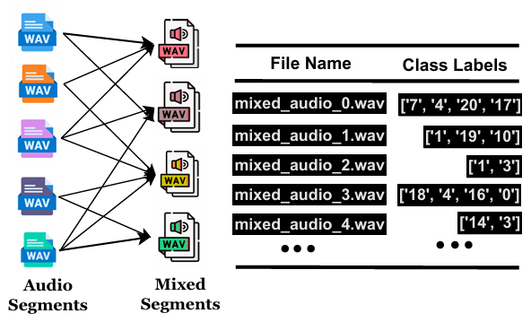
Dataset Overview & Preparation
7
Simulating Overlapping Soundscapes: Mixed Data
Mixed audio files were created by combining 1–4 individual segments
per file.
Two setups: Fixed (3 segments) and Variable (1–4 segments) to simulate overlapping sounds.
A total of 8,000 mixed audio samples were generated.
Simulating Overlapping Soundscapes with Mixed Audio
Fig. 1: Audio Mixing Process and Label Interactions.
The 16th International IEEE Conference on Computing, Communication and Networking Technologies (ICCCNT)

Slide 8
Experimental Setup
8
System Requirements
Hardware: 16Gb RAM, Intel core i7 processor.
Software: Windows 11, Kaggle Cloud Environment & Google Collab.
Programming Language: Python
Training Configuration
Epochs: 100
Batch Size: 16
Optimizer: Adam
Spectrogram Size: 128 x 128 pixels
Learning rate: 0.001
Evaluation Matrics: Precision, Recall, F1-Score and Accuracy
The 16th International IEEE Conference on Computing, Communication and Networking Technologies (ICCCNT)

Slide 9
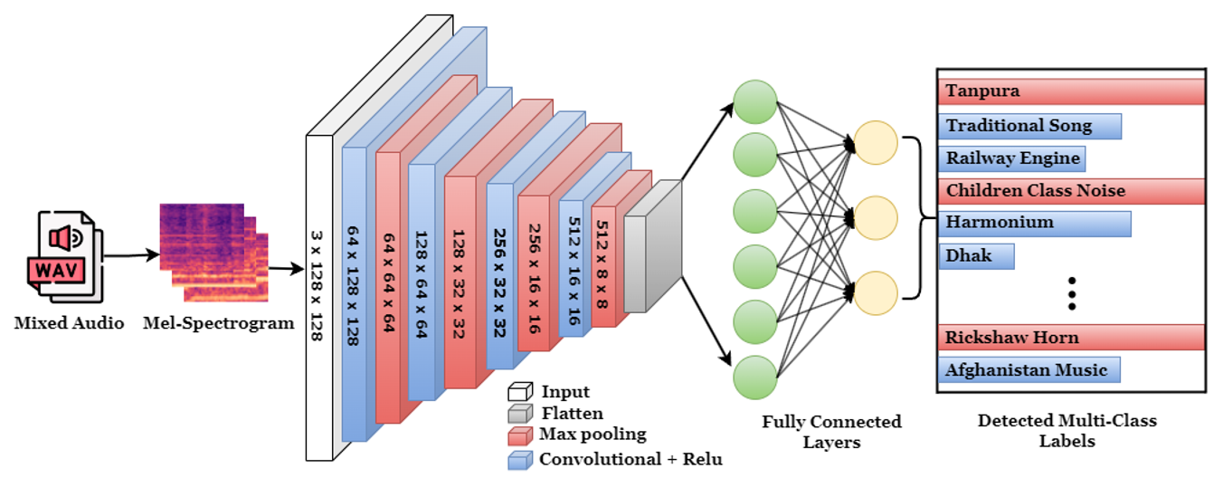
Proposed Methodology
9
Fig. 2: Multilabel Audio Classification Framework
Workflow:
Mixed audio is converted to Mel-spectrograms for the CNN.
Convolution, ReLU, and max pooling extract features; dense layers predict multiple labels.
Uses BCEWithLogitsLoss for efficient multi-label learning.
The 16th International IEEE Conference on Computing, Communication and Networking Technologies (ICCCNT)

Slide 10
Results Analysis
10
Table 1 : Performance Comparison of MFCC and Spectrogram Features on Datasets with Fixed no. Mixed Audio Samples.
Table 2 : Performance Comparison of MFCC and Spectrogram Features on Datasets with Variable no. Mixed Audio Samples.
Dataset | Features | P | R | F1 | Acc.
SAS-KIIT | MFCC | 0.83 | 0.73 | 0.76 | 93.91
 | Spectrogram | 0.87 | 0.78 | 0.81 | 95.42
Urban Sound 8K | MFCC | 0.71 | 0.61 | 0.62 | 84.16
 | Spectrogram | 0.72 | 0.67 | 0.64 | 86.36
Dataset | Features | P | R | F1 | Acc.
SAS-KIIT | MFCC | 0.84 | 0.76 | 0.77 | 94.63
 | Spectrogram | 0.89 | 0.83 | 0.84 | 96.37
Urban Sound 8K | MFCC | 0.68 | 0.65 | 0.62 | 83.94
 | Spectrogram | 0.69 | 0.63 | 0.61 | 85.26
Achieved 95–96% on SAS-KIIT and 85–86% on UrbanSound8K for both fixed and variable mixed audio setups.
Consistent performance across different mixing conditions (1–4 sources) shows the model handles real-world overlapping sounds well.
Shows good generalization for both regional (SAS-KIIT) and general urban (UrbanSound8K) sounds.
The 16th International IEEE Conference on Computing, Communication and Networking Technologies (ICCCNT)

Slide 11
Results Analysis Continued
11
Table 3: Performance Comparison of the Proposed Model, FACE and
PANNs on Datasets Using Spectrogram Features with Variable
Number of Mixed Audio Samples.
Dataset | Features | Precision | Recall | F1-Score | Accuracy
SAS-KIIT | FACE [8] | 0.91 | 0.79 | 0.80 | 95.22
 | PANNs [9] | 0.85 | 0.76 | 0.78 | 92.51
 | Proposed Model | 0.89 | 0.83 | 0.84 | 96.37
UrbanSound8K | FACE [8] | 0.71 | 0.57 | 0.59 | 84.54
 | PANNs [9] | 0.63 | 0.61 | 0.66 | 83.26
 | Proposed Model | 0.69 | 0.63 | 0.61 | 85.26
Achieved higher accuracy than FACE, despite being simpler and faster.
Delivers results close to PANNs, while being less computationally demanding.
Ideal for resource-limited environments, with a good balance of accuracy and efficiency.
The 16th International IEEE Conference on Computing, Communication and Networking Technologies (ICCCNT)

Slide 12
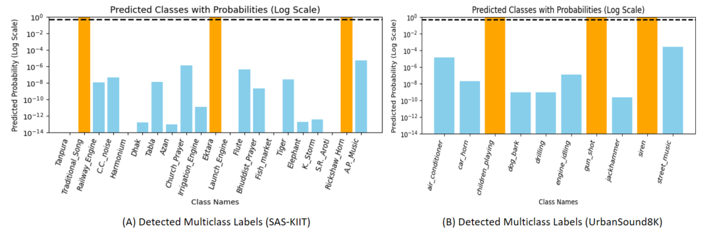
Detection Visualization
12
Fig. 3: Log-Scale Representation of Predicted Audio Classes,
Orange bars indicate classes detected in the sample audio.
The 16th International IEEE Conference on Computing, Communication and Networking Technologies (ICCCNT)

Slide 13
Conclusion
13
Key Takeaways:
Achieved up to 96% on SAS-KIIT and 85% on UrbanSound8K with mixed overlapping sounds.
Handles multi-label classification with spectrogram input, effective for diverse, real-world urban soundscapes.
Simple CNN design makes it suitable for urban monitoring, cultural preservation, and other real-world applications.
Future Directions:
Add Attention or Sequence Models: Integrate attention or temporal modules to capture context better.
Deploy on Edge Devices: Optimize for resource-limited devices to enable real-time field analysis.
Multi-Modal Expansion: Combine with other data types (e.g., video
or sensor data) for richer
The 16th International IEEE Conference on Computing, Communication and Networking Technologies (ICCCNT)

Slide 14
References
14
[1] T. A. Onisha, J. Kim, and J. Seol, “Multi label sound classification using deep learning models,” in 2024 IEEE/ACIS 22nd International Conference on Software Engineering Research, Management and Applications (SERA), 2024, pp. 129–134.
[2] R. Chatterjee, P. Bishwas, S. Chakrabarty, and T. Bandyopadhyay, “South asian sounds: Audio classification,” in 2024 4th International Conference on Computer, Communication, Control & Information Technology (C3IT), 2024, pp. 1–6.
[3] B. Vimal, M. Surya, Darshan, V. Sridhar, and A. Ashok, “Mfcc based audio classification using machine learning,” in 2021 12th International Conference on Computing Communication and Networking Technologies (ICCCNT), 2021, pp. 1–4.
[4] J. Sharma, O.-C. Granmo, and M. Goodwin, “Environment sound classification using multiple feature channels and attention based deep convolutional neural network,” in Interspeech 2020, 2020, pp. 1186–1190.
[5] T. Bandyopadhyay, “Spectron: Target speaker extraction using conditional transformer with adversarial refinement,” arXiv preprint arXiv:2409.01352, 2024.
[6] M. Bubashait and N. Hewahi, “Urban sound classification using dnn, cnn & lstm a comparative approach,” 09 2021, pp. 46–50.
[7] J. Salamon, C. Jacoby and J. P. Bello, "A Dataset and Taxonomy for Urban Sound Research", 22nd ACM International Conference on Multimedia, Orlando USA, Nov. 2014.
[8] M. M. Morsali, H. Mohammadzade, and S. B. Shouraki, “Face: Fast, accurate and context-aware audio annotation and classification,” arXiv preprint arXiv:2303.03666, 2023.
[9] Q. Kong, Y. Cao, T. Iqbal, Y. Wang, W. Wang, and M. D. Plumbley, “Panns: Large-scale pretrained audio neural networks for audio pattern recognition,” IEEE/ACM Transactions on Audio, Speech, and Language Processing, vol. 28, pp. 2880–2894, 2020.
The 16th International IEEE Conference on Computing, Communication and Networking Technologies (ICCCNT)

Slide 15
Thank You
The 16th International IEEE Conference on Computing, Communication and Networking Technologies (ICCCNT)

